Slide 1
Weather Merit Badge
Troop 344 and 9344
Pemberville, OH

Slide 2
Weather Merit Badge Requirements
Define meteorology. Explain what weather is and what climate is. Discuss how the weather affects farmers, sailors, aviators, and the outdoor construction industry. Tell why weather forecasts are important to each of these groups.
Name five dangerous weather-related conditions. Give the safety rules for each when outdoors and explain the difference between a severe weather watch and a warning. Discuss the safety rules with your family.
Explain the difference between high- and low-pressure systems in the atmosphere. Tell which is related to good and to poor weather. Draw cross sections of a cold front and a warm front, showing the location and movements of the cold and warm air, the frontal slope, the location and types of clouds associated with each type of front, and the location of precipitation.

Slide 3
Weather Merit Badge Requirements
Tell what causes wind, why it rains, and how lightning and hail are formed.
Identify and describe clouds in the low, middle, and upper levels of the atmosphere. Relate these to specific types of weather.
Draw a diagram of the water cycle and label its major processes. Explain the water cycle to your counselor.
Identify some human activities that can alter the environment, and describe how they affect the climate and people.
Describe how the tilt of Earth's axis helps determine the climate of a region near the equator, near the poles, and across the area in between.

Slide 4
Weather Merit Badge Requirements
Do ONE of the following:
Make one of the following instruments: wind vane, anemometer, rain gauge, hygrometer. Keep a daily weather log for one week using information from this instrument as well as from other sources such as local radio and television stations, NOAA Weather Radio All Hazards, and Internet sources (with your parent's permission). Record the following information at the same time every day: wind direction and speed, temperature, precipitation, and types of clouds. Be sure to make a note of any morning dew or frost. In the log, also list the weather forecasts from radio or television at the same time each day and show how the weather really turned out.

Slide 5
Weather Merit Badge Requirements
Do ONE of the following:
Visit a National Weather Service office or talk with a local radio or television weathercaster, private meteorologist, local agricultural extension service officer, or university meteorology instructor. Find out what type of weather is most dangerous or damaging to your community. Determine how severe weather and flood warnings reach the homes in your community.

Slide 6
Weather Merit Badge Requirements
Give a talk of at least five minutes to a group (such as your unit or a Cub Scout pack) explaining the outdoor safety rules in the event of lightning, flash floods, and tornadoes. Before your talk, share your outline with your counselor for approval.
Find out about a weather-related career opportunity that interests you. Discuss with and explain to your counselor what training and education are required for such a position, and the responsibilities required of such a position.

Slide 7
Requirement 1
Define meteorology. Explain what weather is and what climate is. Discuss how the weather affects farmers, sailors, aviators, and the outdoor construction industry. Tell why weather forecasts are important to each of these groups.

Slide 8
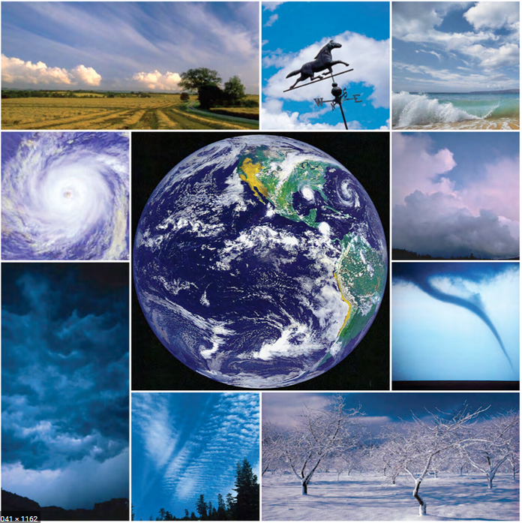
Requirement 1
Meteorology - the branch of science concerned with the processes and phenomena of the atmosphere, especially as a means of forecasting the weather.

Slide 9
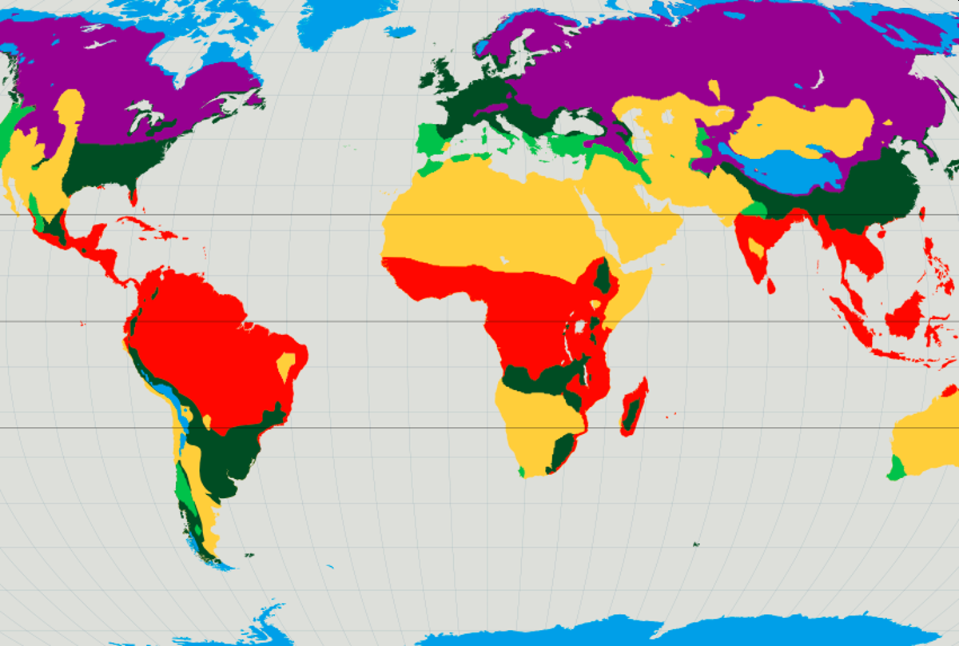
Requirement 1
Climate - the weather conditions prevailing in an area, typically averaged over a period of 30 years.

Slide 10
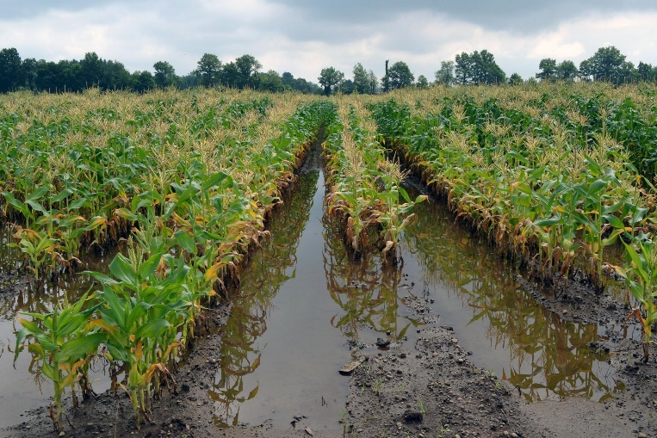
Requirement 1
Weather and Farmers.
Farmers know the importance of wind, rain, and temperature on their plants and animals.
An early frost can ruin a citrus crop.
A bitterly cold winter or a very wet season can reduce the weight gain of livestock.
Farmers plan when to sow, weed, and harvest according to the day-to-day weather forecast.
They also plan what crops to grow according to the seasonal forecast.

Slide 11
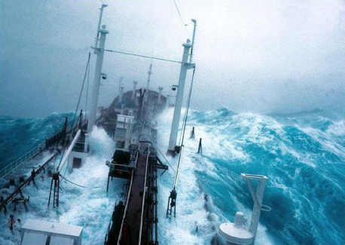
Requirement 1
Weather and Sailors.
Being caught far out at sea during severe weather poses great danger to sailors.
Knowing the forecast can help sailors avoid areas of high wind and other trouble.
Sailors can plan alternative routes to their destinations or choose safe areas in which to work (fishing, for instance) when they have information about the weather.

Slide 12
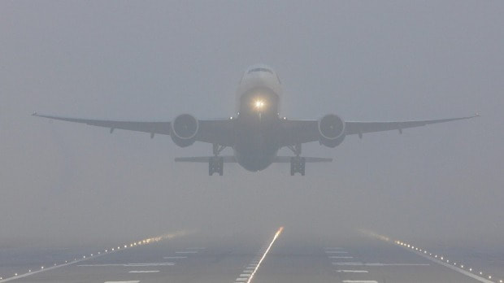
Requirement 1
Weather and Aviators.
Pilots need accurate, up-to-date forecasts to help them make decisions such as whether to land a plane.
If a destination airport is fogged in or has icy runways, the pilot may delay departure or land at a different airport.
If there is a thunderstorm brewing along the planned route, a pilot can take an alternate route.
Pilots also take advantage of good weather, letting the tailwind push the plane along to save fuel.

Slide 13
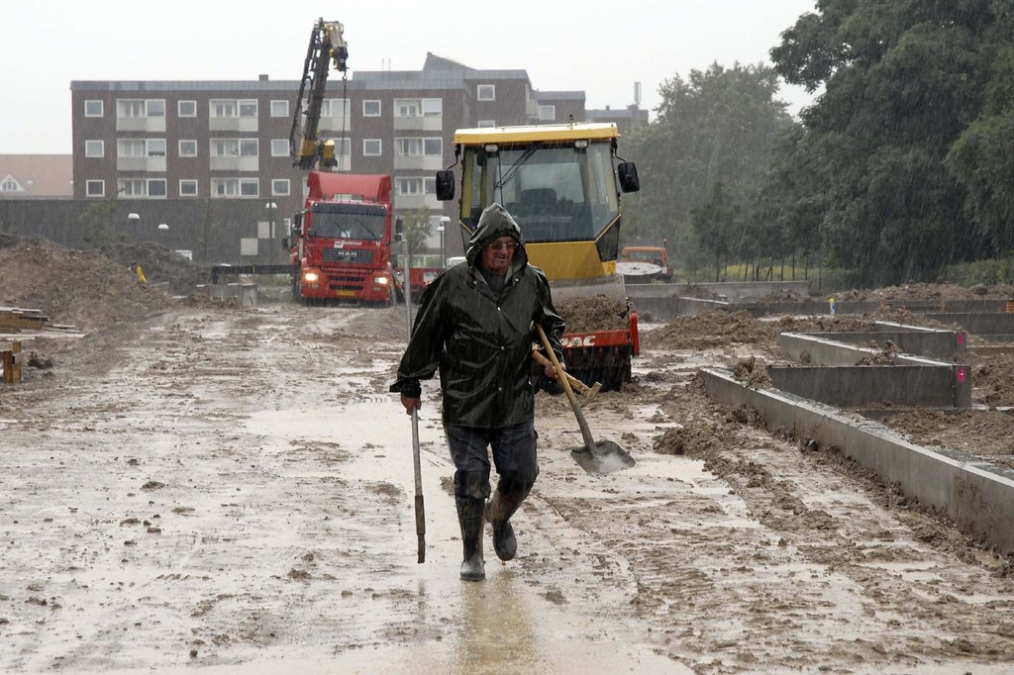
Requirement 1
Weather and Outdoor Construction Workers.
Builders and other people in the field of construction pay close attention to weather forecasts.
Road-paving crews, roofers, painters, and others cannot do their work successfully in the rain.
Wind can endanger those who must keep their balance high above the ground.
Many building materials such as paint may be used effectively only within certain limits of humidity and temperature.

Slide 14
Requirement 2
Name five dangerous weather-related conditions. Give the safety rules for each when outdoors and explain the difference between a severe weather watch and a warning. Discuss the safety rules with your family.

Slide 15
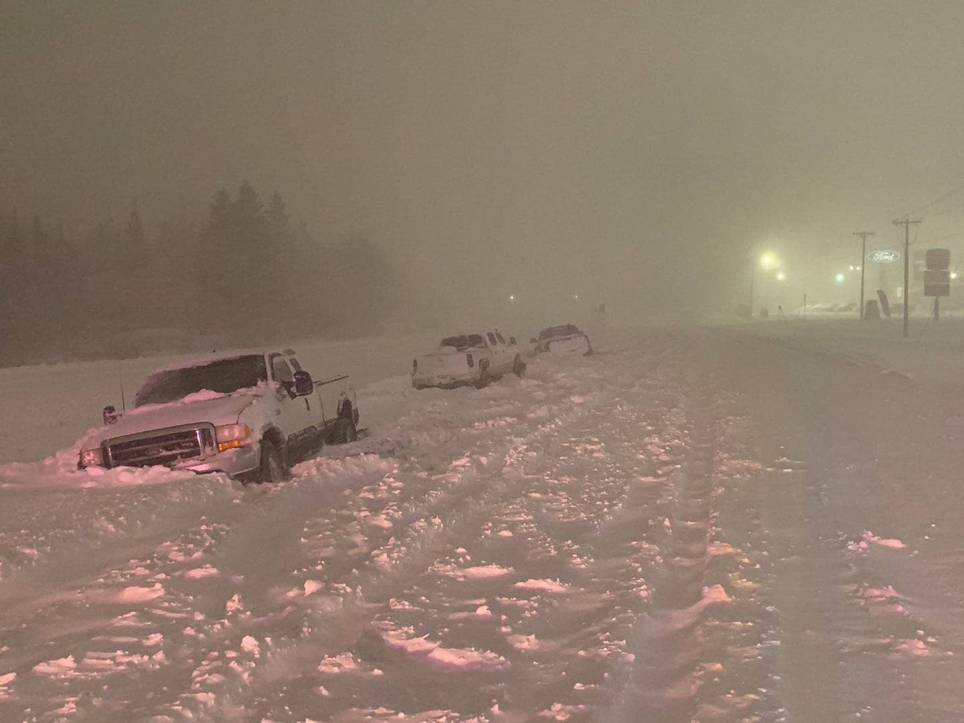
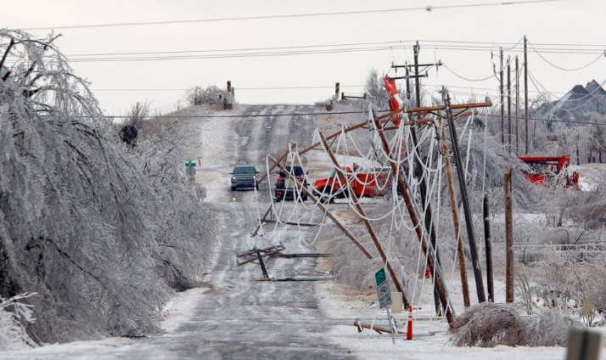
Requirement 2
Winter Storms can bring heavy snow, strong winds, and cold temperatures which can be deadly for people caught unprepared.
Freezing Rain can build up ice on tree branches that can break and crash into power and telephone lines already burdened with ice. Roads become ice-covered and treacherous.

Slide 16
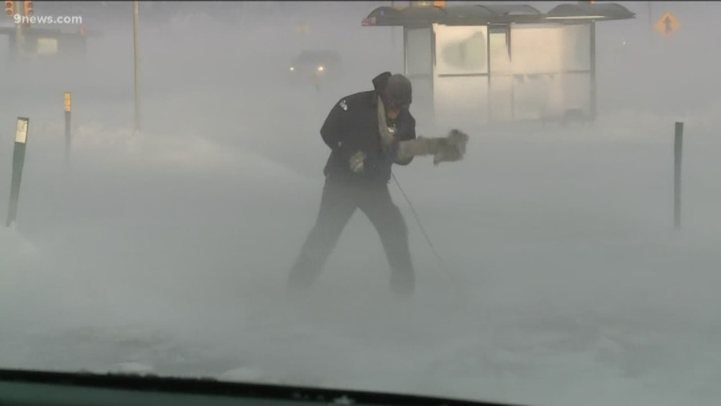
Requirement 2
Extreme Cold is dangerous but can be even more hazardous when accompanied by high wind.
The two combined increase the rate of heat loss from exposed skin.
The result can be frostbite, which is damage to skin from freezing, or hypothermia, a dangerous lowering of body temperature.

Slide 17
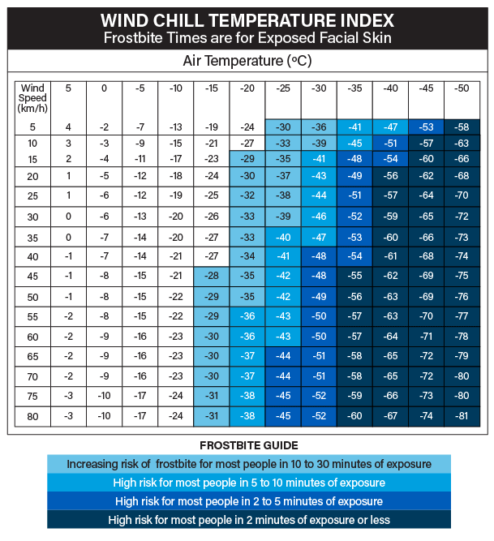
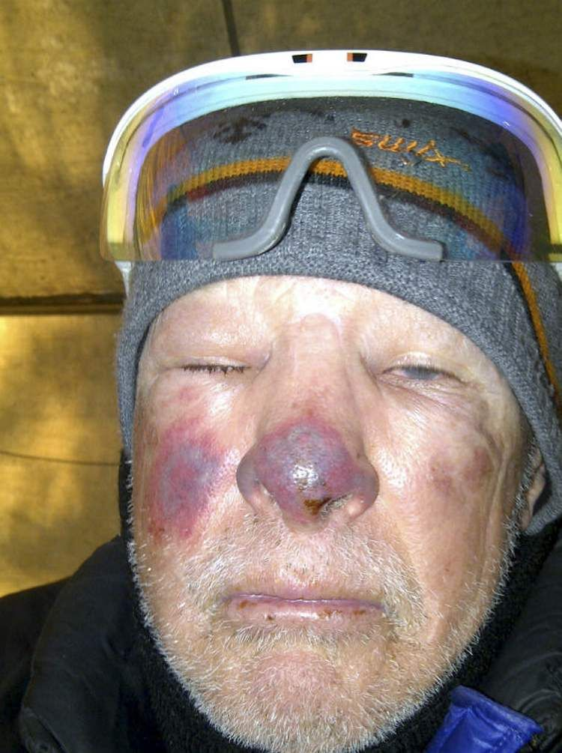
Requirement 2
Wind Chill describes the combined effect of cold and wind and is useful for estimating the danger of frostbite.

Slide 18
Requirement 2
Safety and Winter Storms.
If you are caught outdoors in a winter storm, it is important to stay dry, cover all exposed parts of your body (several layers of clothing provide more protection than a single heavy coat), and avoid overexertion to help prevent frostbite and hypothermia.
If there is no shelter available, prepare a lean-to, windbreak, or snow cave for protection from the wind.
Build a fire if possible to provide heat and attract the attention of rescuers.
If you are out in a car, stay with the car and tie a brightly colored cloth to the antenna so that you might be seen by rescuers.
For about 10 minutes each hour, start the car and run the heater making sure the car’s exhaust pipe is not blocked; otherwise, deadly exhaust fumes will fill your car.

Slide 19
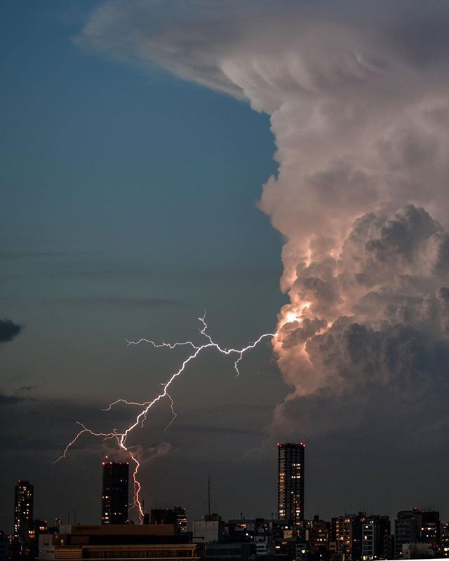
Requirement 2
Thunderstorms form when warm, moist air creates updrafts that form large precipitation drops in clouds.
As this precipitation develops, positive and negative electrical charges separate and build up in different parts of the clouds and on the ground beneath the clouds.
When charges have built up enough, they can “jump the gap” between regions of opposite charge, discharging the areas creating what we call lightning.
In the United States about 90 people die each year from being struck by lightning.

Slide 20
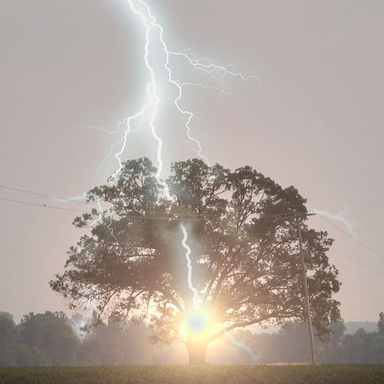
Requirement 2
Staying Safe During a Thunderstorm
Do not stand in open areas or near lightning targets such as trees, power poles, or wire fences.
Metal conducts electricity, so also stay away from metal poles (such as tent poles) and such.
Water also conducts electricity, so if you are boating or swimming, get to land immediately when a storm is approaching.

Slide 21
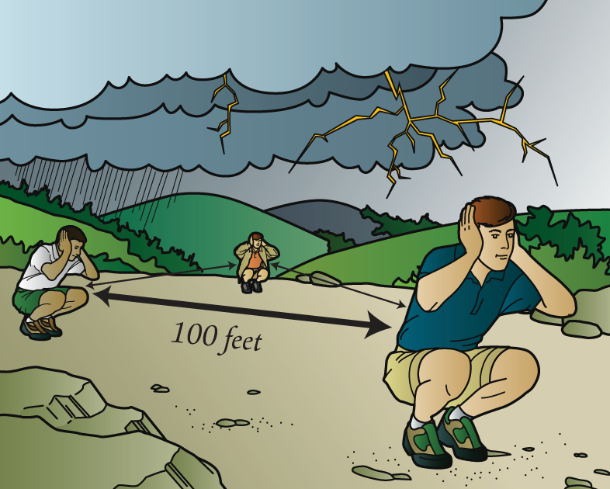
Requirement 2
Staying Safe During a Thunderstorm
When hiking near mountaintops get downhill before the lightning begins, if possible.
If a storm catches you, take shelter in a cave or a low spot among the rocks, making sure to avoid prominent outcroppings and overhangs.
If you cannot find shelter, become the smallest target you can.
Squat on the balls of your feet, cover your ears with your hands, and get your head close to your knees.

Slide 22
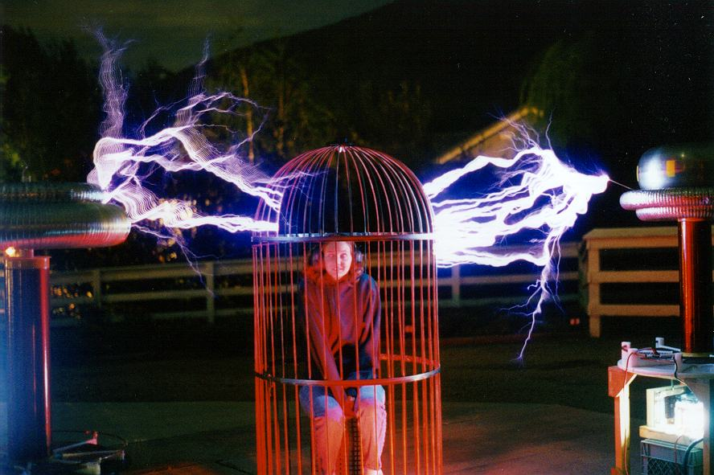
Requirement 2
Staying Safe During a Thunderstorm
Take shelter in a steel-framed building or hard-topped motor vehicle if you can.
Such places are safe because the charge stays within the frame of the building or vehicle and is conducted safely to ground without endangering the occupants.
During a thunderstorm, do not use objects connected to electrical power.
Staying near stoves, fireplaces, and plumbing is also dangerous, because metal can conduct electricity.
Faraday cage protection from lightning strikes much like a steel framed building or car.

Slide 23
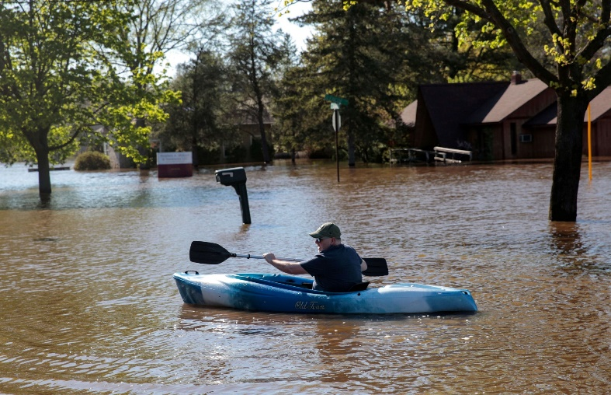
Requirement 2
Floods
Torrential rains of thunderstorms or tropical cyclones can cause flooding.
Some floods occur when winter or spring rains combine with melting snows to fill river basins with too much water too quickly.
Such events usually take several days to develop.
Other floods arise suddenly as the result of heavy localized rainfall.
These flash floods can become raging torrents very fast, sometimes in less than an hour, and can sweep away everything in their path.

Slide 24
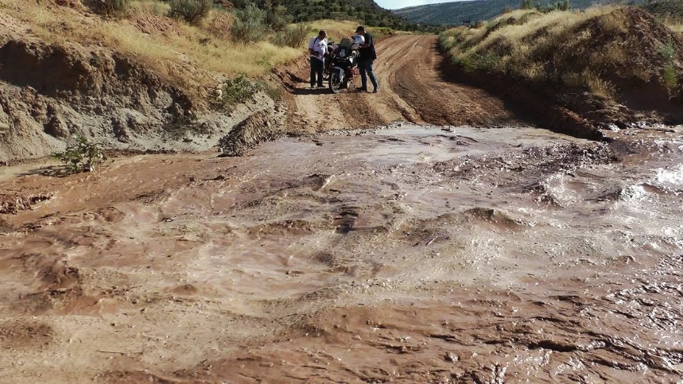
Requirement 2
Floods
Floods that arise suddenly as the result of heavy localized rainfall are called flash floods.
They can become raging torrents very fast, sometimes in less than an hour, and can sweep away everything in their path.

Slide 25
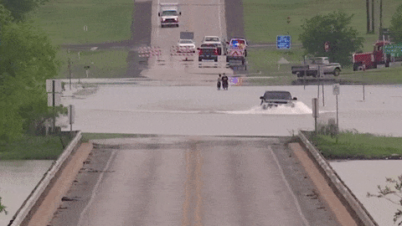
Requirement 2
Safety and Flooding
When camping, stay clear of natural streambeds during the time of year when rainstorms are common.
In case of a flood in rugged terrain, climb to high ground immediately, even if it means abandoning your gear.
Never enter a flooded low spot on the road or trail if you do not know how deep the water is, especially if the water is rising.
Most fatalities of floods are victims trapped in automobiles.
It takes only 2 feet of water to float a car, and even less to stall a car or truck’s engine.

Slide 26
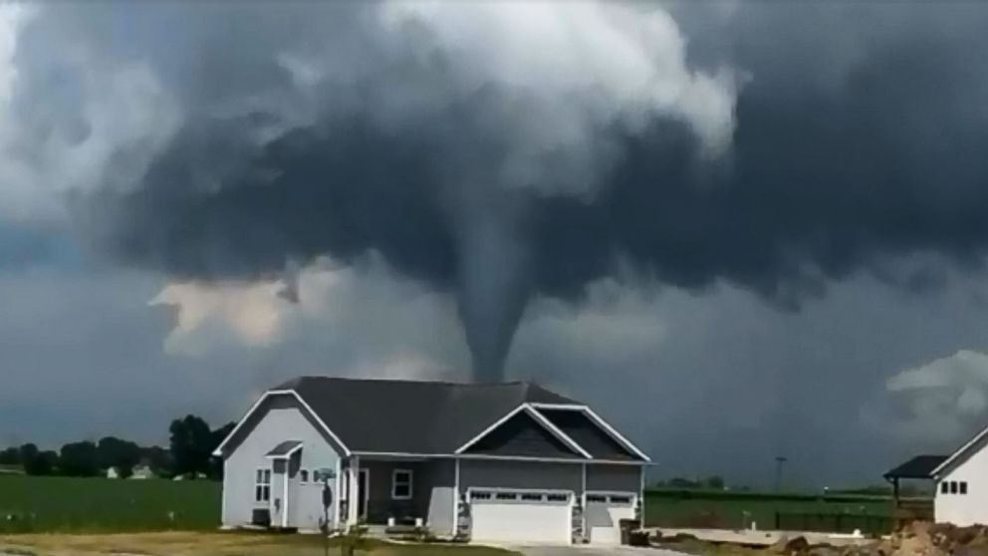
Requirement 2
Tornadoes
On rare occasions, rapidly rotating columns of air form within a thunderstorm.
When these rotating columns reach Earth’s surface, they become tornadoes.
Tornadoes can produce the strongest winds on Earth, occasionally reaching 300 miles per hour or more.

Slide 27
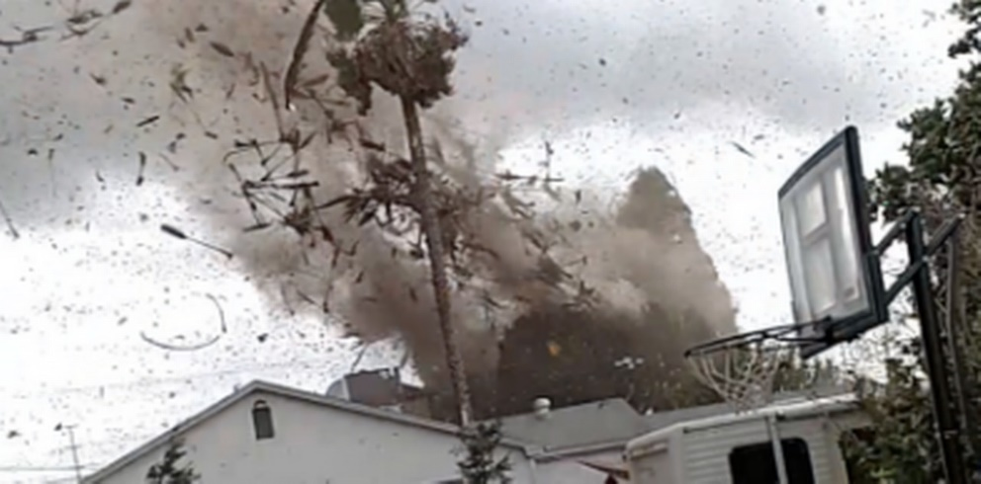
Requirement 2
Tornado Safety
Most tornado casualties are caused by flying debris, so the best thing to do if a tornado threatens is to get to a place that provides as much protection from flying debris as possible.
If you are caught in the open when a tornado approaches, get to a low spot, lie face down, and cover your head.

Slide 28
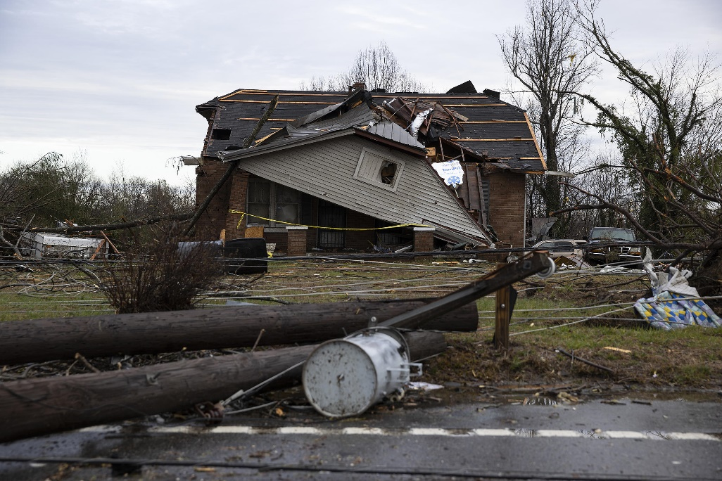
Requirement 2
Tornado Safety
If you cannot get to a tornado shelter or basement, put as many solid walls between you and the outside as possible.
Closets in interior hallways are good shelters as well as bathrooms.
Stay away from windows— flying glass is extremely hazardous.
Abandon mobile homes and seek nearby shelter.
If your home is hit, be alert to leaking gas from broken pipes and fallen power lines.

Slide 29
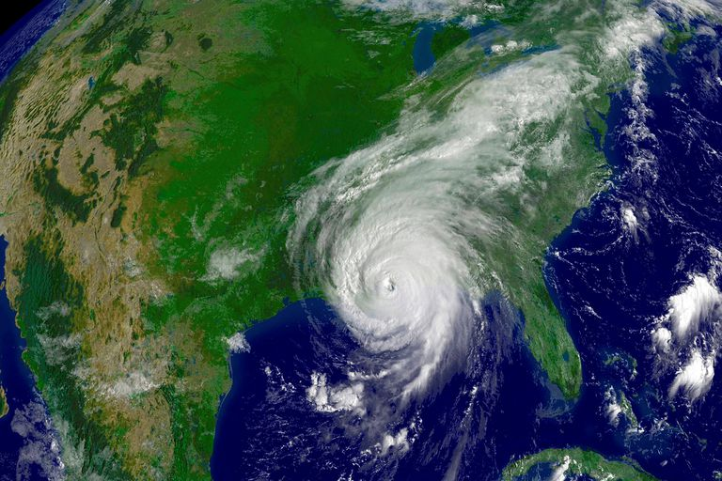
Requirement 2
Hurricanes
The most dangerous storms that affect the United States are hurricanes.
When well-developed, they are nearly circular in shape and vary in diameter from about 100 to 1,000 miles.
In rare instances, their winds can exceed 200 miles per hour.

Slide 30
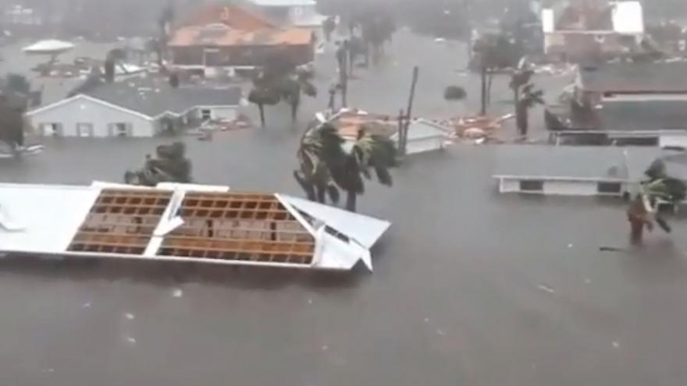
Requirement 2
Hurricanes
The combined effects of the winds and the low pressure act to pile up ocean water at the center of the storm, producing a storm surge.
As the storm approaches land, the storm surge can combine with normal tides to produce extensive flooding.
It is the storm surge, not the wind, that causes the most damage and the most casualties from hurricanes.

Slide 31
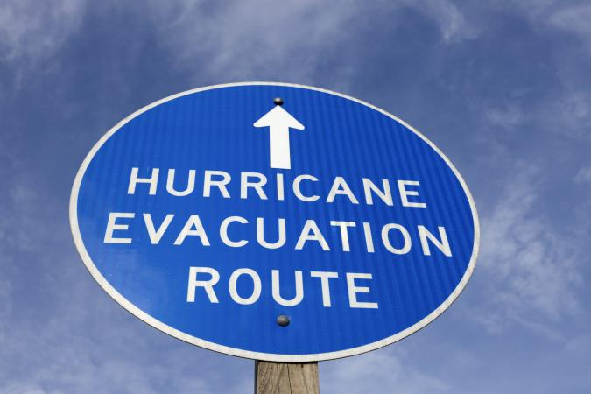
Requirement 2
Hurricane Safety
In nearly all cases, hurricane watches and warnings will precede landfall of the hurricane.
If you are camping along or near a seashore when hurricane watches are issued, strike camp and leave the area immediately.
If officials have not advised that you evacuate the area, stay indoors, away from windows, and follow the guidelines for tornado safety.

Slide 32
Requirement 2
A WATCH means that the potential exists for the development of severe thunderstorms or tornadoes, depending upon the specific type of watch issued.
A WARNING indicates that severe weather is imminent in your area or is already occurring (based on either human observation or Doppler radar).

Slide 33
Requirement 2

Slide 34
Requirement 3
Explain the difference between high- and low-pressure systems in the atmosphere. Tell which is related to good and to poor weather. Draw cross sections of a cold front and a warm front, showing the location and movements of the cold and warm air, the frontal slope, the location and types of clouds associated with each type of front, and the location of precipitation.

Slide 35
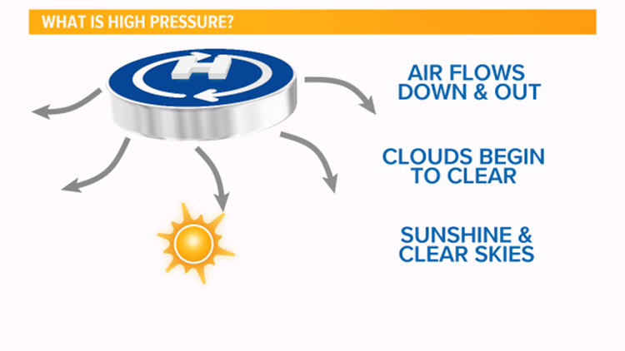
Requirement 3
A high pressure system has higher pressure at its center than the areas around it.
Winds blow away from high pressure causing air to flow downwards.
As the air sinks, clouds begin to clear and weather becomes sunny.

Slide 36
Requirement 3
A low pressure system has lower pressure at its center than the areas around it.
Winds blow towards the low pressure, and the air rises in the atmosphere where they meet.
As the air rises, the water vapor within it condenses, forming clouds and often precipitation.

Slide 37
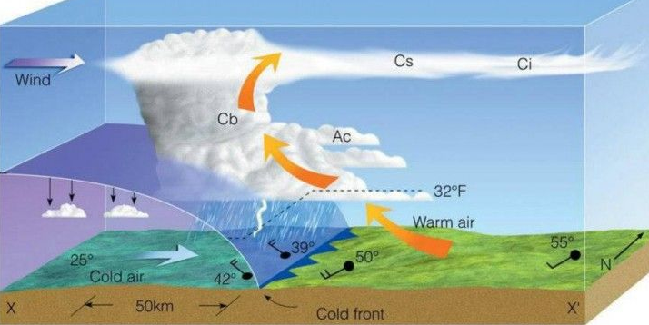
Requirement 3
Cloud Types
Ci – Cirrus
Cs – Cumulocirrus
Cb – Cumulonimbus
Ac – Alto cumulus
A cold front is defined as the transition zone where a cold air mass is replacing a warmer air mass.
Cold fronts generally move from northwest to southeast.
The air behind a cold front is noticeably colder and drier than the air ahead of it.

Slide 38
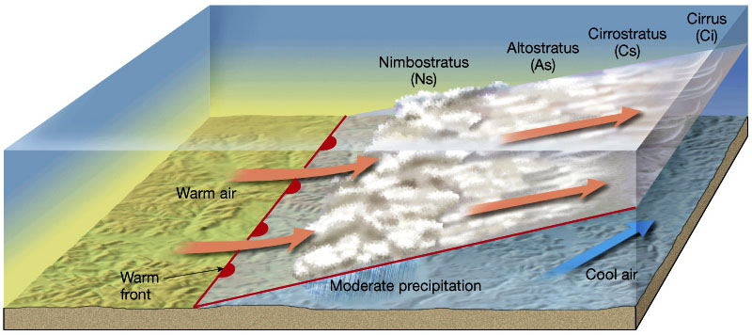
Requirement 3
A warm front is defined as the transition zone where a warm air mass is replacing a cold air mass.
Warm fronts generally move from southwest to northeast and the air behind a warm front is warmer and more moist than the air ahead of it.

Slide 39
Requirement 4
Tell what causes wind, why it rains, and how lightning and hail are formed.

Slide 40
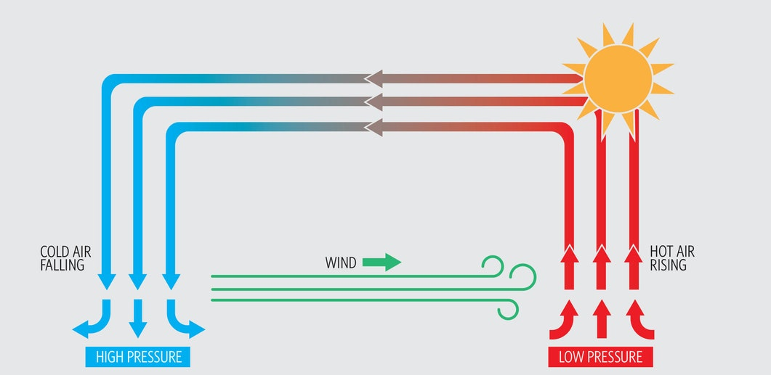
Requirement 4
Wind
Because the sun hits different parts of the Earth at different angles, and because Earth has oceans, mountains, and other features, some places are warmer than others.
Warm air rises and leaves behind an area of low pressure behind it.
Cold air sinks and creates an area of high pressure.
When a difference in atmospheric pressure exists, air moves from the higher to the lower pressure area, resulting in winds of various speeds.

Slide 41
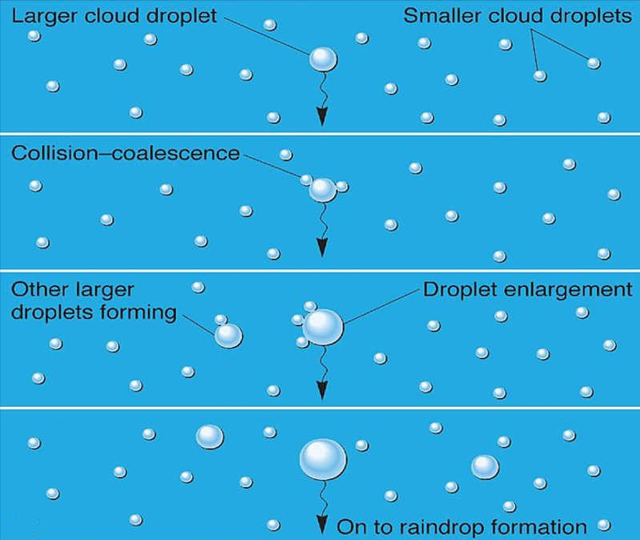
Requirement 4
Rain
A cloud is made of water vapor that has condensed into tiny water droplets or ice crystals.
As more and more water vapor condenses, some of the particles collide with each other and merge to form droplets large enough to begin to fall.
As they fall, they continue to grow by sweeping up smaller droplets along the way—a process called coalescence.
When droplets become just large and heavy enough to fall to the earth, they are called drizzle.
As the droplets continue to grow, they reach a size large enough to be called rain.

Slide 42
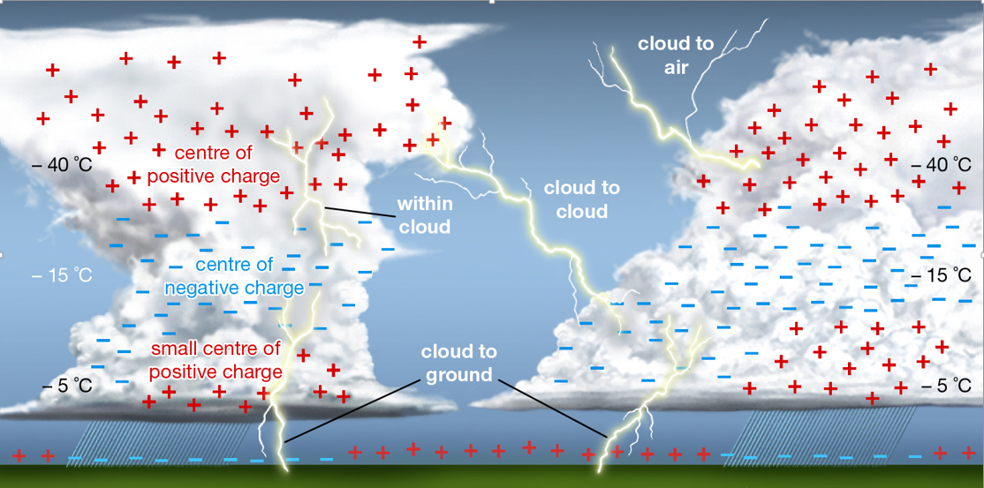
Requirement 4
Lightning
Charges develop within the cloud because of collisions between ice particles.
As the charged particles spread apart within the cloud, larger regions of charge develop.
When this charge gets large enough, a lightning strike occurs between the clouds.
Sometimes this happens between the cloud and the ground.
A charge builds up on the ground beneath the cloud, attracted to the opposite charge in the bottom of the cloud.
The ground's charge concentrates around anything that sticks up - trees, lightning rods, even people!
The charge from the ground connects with the opposite charge from the clouds and lightning strikes.

Slide 43
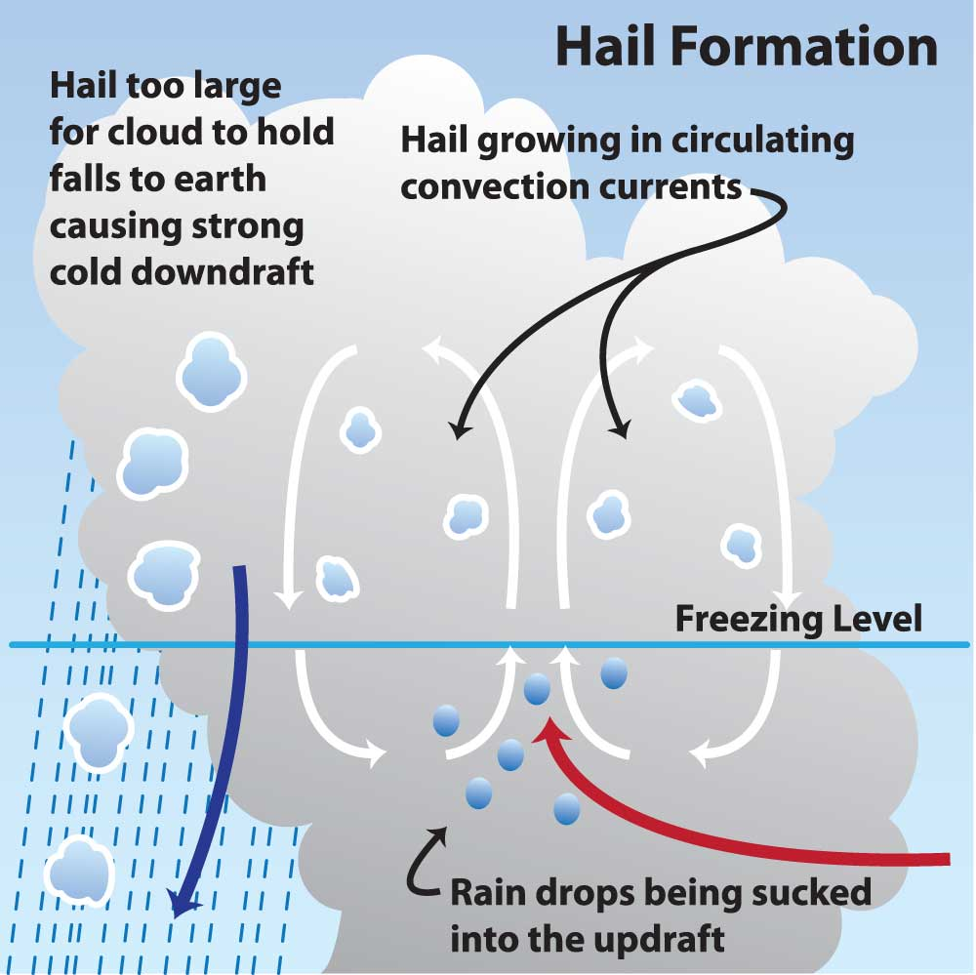
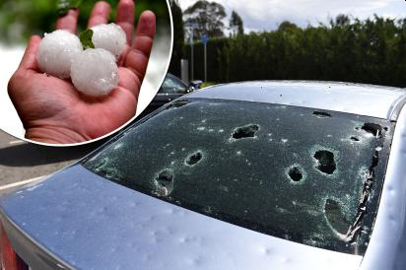
Requirement 4
Hail
Hailstones are formed when raindrops are carried upward by thunderstorm updrafts into extremely cold areas of the atmosphere and freeze.
As the hailstone moves up and down through a storm, it collides with water droplets, growing larger with each collision.
The hail falls to the earth when the thunderstorm's updraft can no longer support the weight of the hailstone.
Hailstones can be as large as oranges and grapefruits.

Slide 44
Requirement 5
Identify and describe clouds in the low, middle, and upper levels of the atmosphere. Relate these to specific types of weather.

Slide 45
Requirement 5

Slide 46
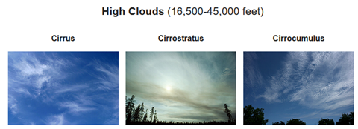
Requirement 5
Cirrus clouds are delicate feathery clouds that are made mostly of ice crystals.
Weather prediction: A change is on its way.
Cirrostratus clouds are thin, white clouds that cover the whole sky.
Weather prediction: Rain or snow will arrive within 24 hours.
Cirrocumulus clouds are thin, sometimes patchy, sheet-like clouds. They sometimes look like they’re full of ripples or are made of small grains.
Weather prediction: Fair, but cold.

Slide 47
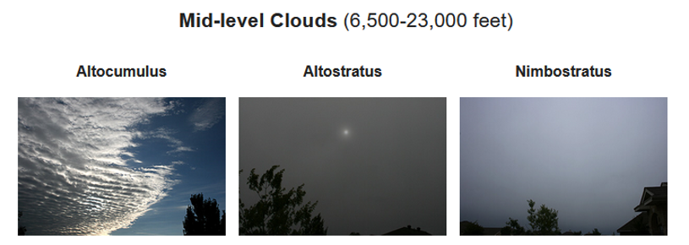
Requirement 5
Altocumulus clouds have several patchy white or gray layers and seem to be made up of many small rows of fluffy ripples..
Weather prediction: Fair.
Altostratus clouds are gray or blue-gray and usually cover the entire sky.
Weather prediction: Be prepared for continuous rain or snow.
Nimbostratus clouds are dark, gray clouds that seem to fade into falling rain or snow. They often blot out the sunlight.
Weather prediction: Gloomy with continuous rain or snow.

Slide 48
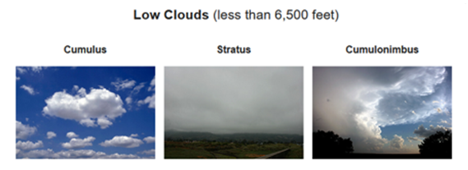
Requirement 5
Cumulus clouds look like fluffy, white cotton balls.
Weather prediction: Fair.
Stratus clouds look like thin, white sheets that cover the whole sky.
Weather prediction: Fair, but gloomy.
Cumulonimbus clouds grow on hot days when warm, wet air rises very high into the sky. From far away, they look like huge towers.
Weather prediction: Watch for rain, hail, and tornadoes.

Slide 49
Requirement 6
Draw a diagram of the water cycle and label its major processes. Explain the water cycle to your counselor.

Slide 50
Requirement 6
The water cycle describes how water evaporates from the surface of the earth, rises into the atmosphere, cools and condenses into rain or snow in clouds, and falls again to the surface as precipitation. The water falling on land collects in rivers and lakes, soil, and porous layers of rock, and much of it flows back into the oceans, where it will once more evaporate. The cycling of water in and out of the atmosphere is a significant aspect of the weather patterns on Earth.

Slide 51
Requirement 7
Identify some human activities that can alter the environment, and describe how they affect the climate and people.

Slide 52
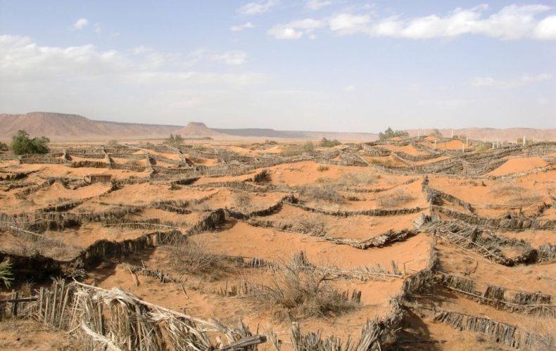
Requirement 7
Desertification
Many areas that now are deserts once were fertile and productive.
In such places, overgrazing, unsound farming methods, or mining have stripped the land of its protective plant cover and caused desertification of the land.

Slide 53
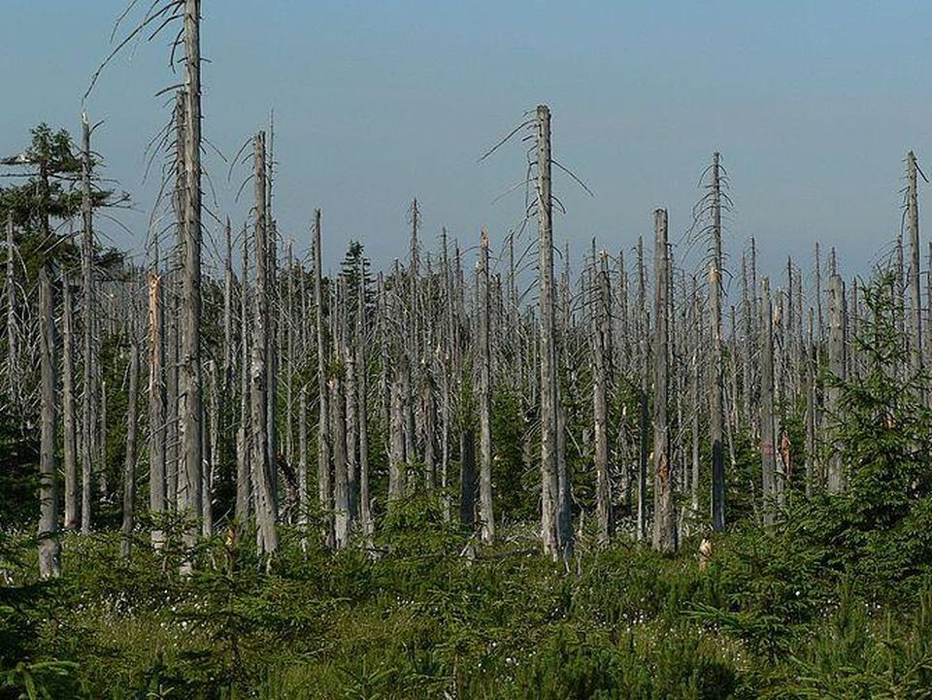
Requirement 7
Acid Rain
Rain becomes acidic when it is polluted by acidic substances emitted into the atmosphere by vehicles, power plants, and factories.
Acid rain can destroy life in lakes and rivers, which results in damage to the water cycle, crops, forests, outdoor statues, and buildings.

Slide 54
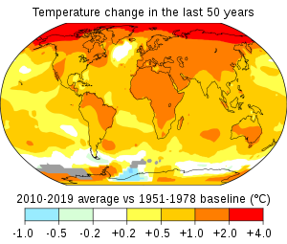
Requirement 7
Global Warming
Global warming occurs when carbon dioxide (CO₂) and other air pollutants and greenhouse gases collect in the atmosphere and absorb sunlight and solar radiation that have bounced off the earth’s surface.
Normally, this radiation would escape into space—but these pollutants, which can last for years to centuries in the atmosphere, trap the heat and cause the planet to get hotter.
That's what's known as the greenhouse effect.

Slide 55
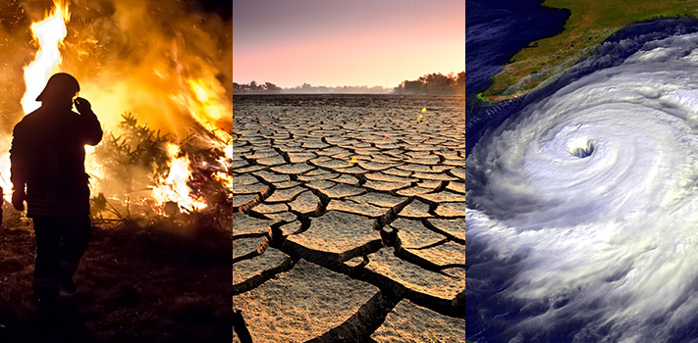
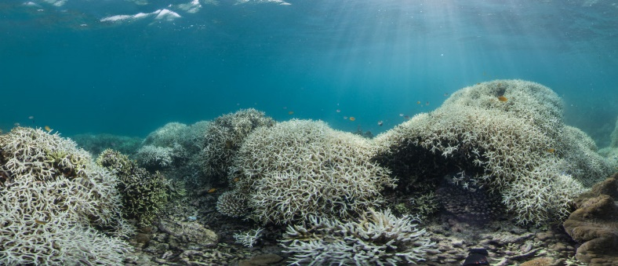
Requirement 7
Effects of Global Warming
The earth’s rising temperatures are fueling longer and hotter heat waves, more frequent droughts, heavier rainfall, and more powerful hurricanes.
Melting glaciers, early snowmelt, and severe droughts will cause more dramatic water shortages and increase the risk of wildfires in the American West.
Rising sea levels will lead to coastal flooding on the Eastern Seaboard, especially in Florida, and in other areas such as the Gulf of Mexico.
Forests, farms, and cities will face troublesome new pests, heat waves, heavy downpours, and increased flooding. All those factors will damage or destroy agriculture and fisheries.
Disruption of habitats such as coral reefs and Alpine meadows could drive many plant and animal species to extinction.

Slide 56
Requirement 7
Ozone Layer Depletion
Ozone depletion of Earth’s ozone layer in the upper atmosphere is caused by the release of chemical compounds containing gaseous chlorine or bromine from industry and other human activities.
The thinning is most pronounced in the polar regions, especially over Antarctica.
Ozone depletion is a major environmental problem because it increases the amount of ultraviolet (UV) radiation that reaches Earth’s surface, which increases the rate of skin cancer, eye cataracts, and genetic and immune system damage.
The Montreal Protocol, ratified in 1987, was the first of several comprehensive international agreements enacted to halt the production and use of ozone-depleting chemicals.
As a result of continued international cooperation on this issue, the ozone layer is expected to recover over time.

Slide 57
Requirement 8
Describe how the tilt of Earth's axis helps determine the climate of a region near the equator, near the poles, and across the area in between.

Slide 58
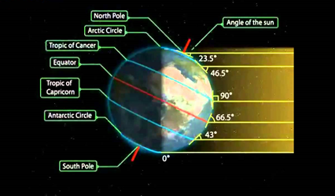
Requirement 8
Earth's axial tilt
The axial tilt angle affects climate largely by determining which parts of the earth get more sunlight during different stages of the year.
This is the primary cause for the different seasons Earth experiences throughout the year, as well as the intensity of the seasons for higher latitudes.

Slide 59
Requirement 9
Do ONE of the following:
Make one of the following instruments: wind vane, anemometer, rain gauge, hygrometer. Keep a daily weather log for one week using information from this instrument as well as from other sources such as local radio and television stations, NOAA Weather Radio All Hazards, and Internet sources (with your parent's permission). Record the following information at the same time every day: wind direction and speed, temperature, precipitation, and types of clouds. Be sure to make a note of any morning dew or frost. In the log, also list the weather forecasts from radio or television at the same time each day and show how the weather really turned out.

Slide 60
Requirement 9a
Wind Vane - helps you determine the direction the wind is blowing.
Draw a triangle onto thick paper, then cut it out. Use a ruler to draw a 4 cm (1.6 in) line onto your paper to make a base for a triangle. Next, place your ruler perpendicular to the line at the halfway mark and trace a 5 cm (2.0 in) line to make an upside down "T." Then, use your ruler to draw lines connecting the top of the upside down "T" to each side of the base line. Finally, cut out the triangle with a pair of scissors.

Slide 61
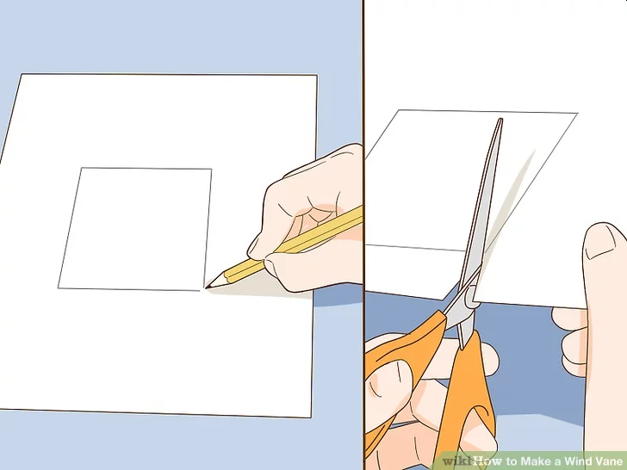
Requirement 9a
Wind Vane
Draw a square onto thick paper, then cut it out. Make your square about 7 cm (2.8 in) long on each side, with your sides roughly even. It’s okay to estimate the measurements, but it’s best to draw your square larger than the triangle. Then, use a pair of scissors to cut out the square, which will be the other end of your arrow.

Slide 62
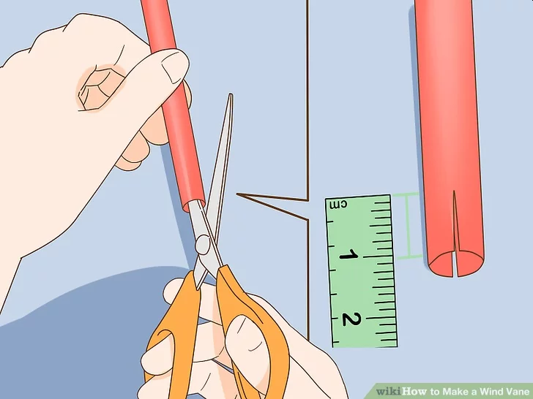
Requirement 9a
Wind Vane
Cut a 1 cm (0.39 in) slit in each end of a drinking straw. Hold your scissors parallel to the straw. Then cut an even slit through each side so that your arrow pieces will slide onto the ends of the straw. Although they don’t need to be exact, your slits should be about 1 centimeter (0.39 in) long and directly opposite each other so you can stick the paper in them.

Slide 63
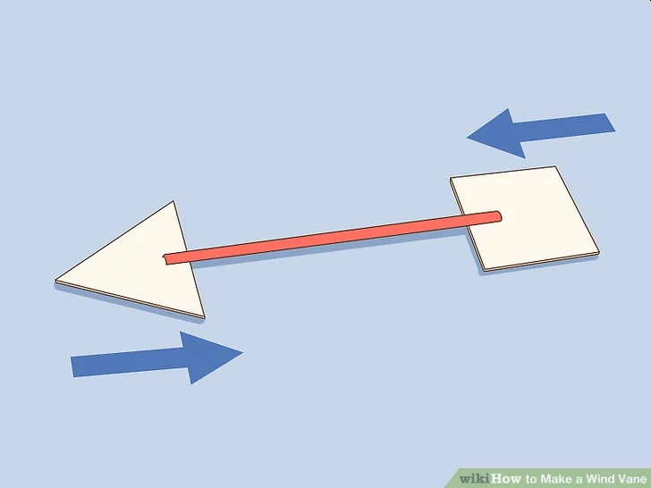
Requirement 9a
Wind Vane
Stick the triangle and square into the slots on the straw to make an arrow. Put the triangle on one end of the straw with the point facing out. Then, slide the square onto the other end. When you’re finished, your straw will look like an arrow.

Slide 64
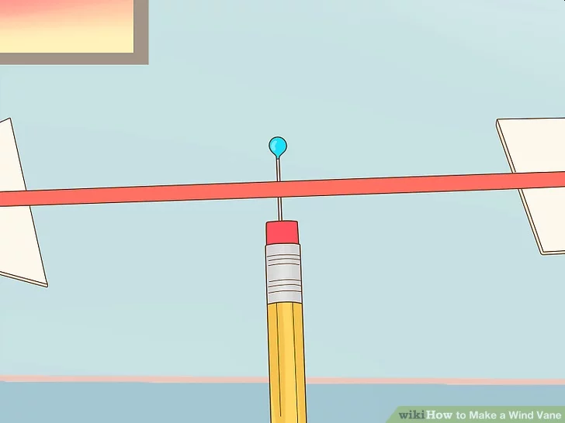
Requirement 9a
Wind Vane
Put a pin through the center of the straw and into the pencil eraser. Find the center of the straw, then push the point of a straight pin through it. Keep pushing until the pin exits the bottom of the straw. Then, push the point of the pin into the center of your pencil’s eraser.

Slide 65
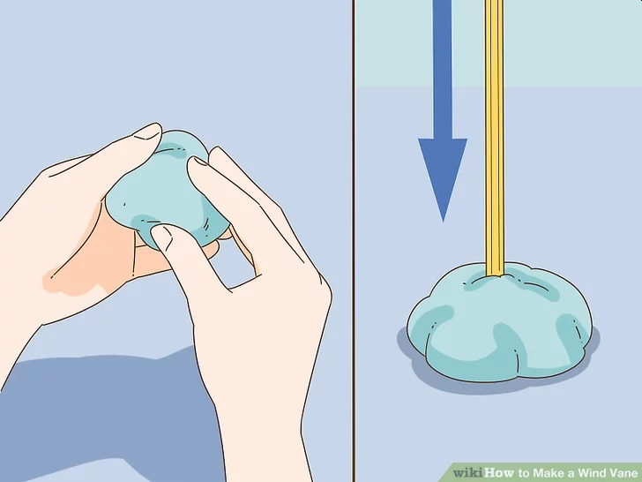
Requirement 9a
Wind Vane
Use a big piece of soft clay as a quick and easy base. Roll the piece of clay into a ball. Then, press the point of your pencil into the clay. The clay will act as a weight to keep your wind vane in place.

Slide 66
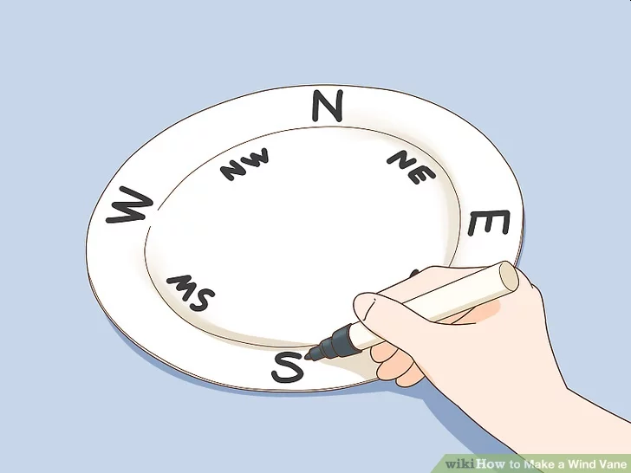
Requirement 9a
Wind Vane
Write the 4 primary and 4 intermediate directions on a paper plate. Write North (N) at the top of the plate. Then, go clockwise and write East (E) on the right side, South (S) on the bottom, and West (W) on the left side. If you’d like, add Northeast (NE) halfway between North and East, Southeast (SE) halfway between East and South, Southwest (SW) halfway between South and West, and Northwest (NW) halfway between North and West.

Slide 67
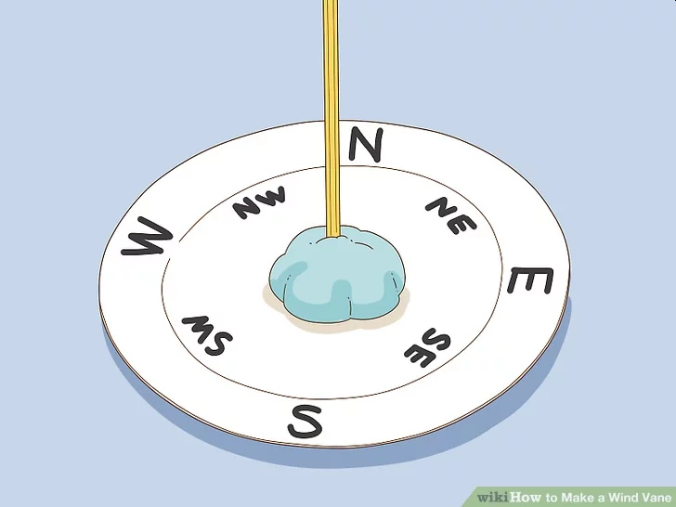
Requirement 9a
Wind Vane
Push the clay ball into the center of plate to keep it in place. Press the bottom of the clay ball onto the center of the plate. Then, use your fingers to push down the edges of the clay to root it in place. This will keep your wind vane in the center of your plate while you use it to measure the direction of the wind.

Slide 68
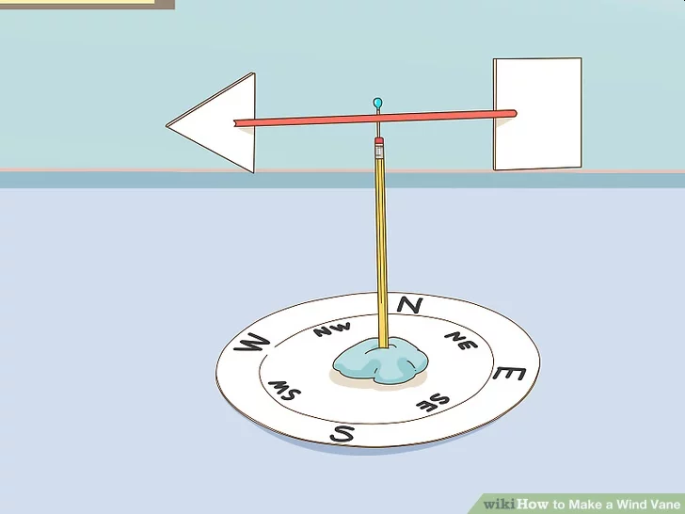
Requirement 9a
Wind Vane
Take your wind vane outside to find the direction the wind is blowing. Use your compass to find the direction of North, then point the North side of your weather vane in the correct direction. Stand away from walls and large objects that could block the wind. Next, watch for your wind vane to start spinning. It will point in the direction the wind is coming from.

Slide 69
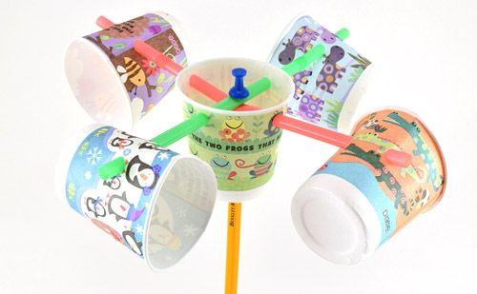
Requirement 9a
Anemometer - a tool made to measure the speed of wind.
Materials Needed:
five 3 oz. plastic cups
two plastic soda straws
one pencil (with unused eraser)
single-hole paper punch
scissors
tape
one push-pin
permanent magic marker

Slide 70
Requirement 9a
Anemometer
Step 1
Take four of the plastic cups and punch one hole in each, about ½ inch (1.5 cm) below the rim.
Step 2
Take the fifth cup and punch two holes in it, directly opposite from each other, about ½ inch (1.5 cm) below the rim. Now punch two more holes in the cup, each ¼ inch (1 cm) below the rim that are equally-spaced between the first two holes.
Step 3
Using the push-pin and the scissors, make a hole in the center of the bottom of the cup with four holes in it. The hole should be large enough that the pencil can fit easily through it.

Slide 71
Requirement 9a
Anemometer
Step 4
Slide one of the straws through the hole in one of the cups that has only one hole in it. Bend the end of the straw that is inside the cup about ½ inches (1.5 cm) and tape it to the inside of the cup.
Step 5
Place the other end of the straw through two of the holes in the fifth cup and then trough the hole in one of the other cups. Tape the end of the straw to the inside of the cup as you did earlier, making sure that the openings of the two cups face opposite directions.

Slide 72
Requirement 9a
Anemometer
Step 6
Repeat steps 4 and 5 with the remaining two cups, sliding the straw through the remaining two holes in the fifth cup. Make sure that the opening of each cup faces the bottom of the cup next to it (in other words, no two openings should be facing each other). Each of the four cups should be facing sideways.
Step 7
Insert the pencil with the eraser facing up through the bottom of the fifth cup. Carefully push the pin through the two straws and into the eraser on the pencil.

Slide 73
Requirement 9a
Anemometer
Step 8
Take the permanent magic marker and draw a large X on the bottom of one of the cups.
Your anemometer is now ready to use! Take it outside and hold it in front of you in an open area where the wind is blowing.
Look at the X on the bottom of the cup as it spins around. Count the number of times it spins around (revolutions) in 10 seconds. Use the following table to estimate the wind speed.

Slide 74
Requirement 9a

Slide 75
Requirement 9a
Rain Gauge - Rain is measured with a rain gauge.

Slide 76
Requirement 9a
Wet-bulb Hygrometer - A common instrument for finding out the amount of water vapor in the air.
Purchase two identical liquid-in-glass alcohol thermometers.
Found in most hardware stores for a reasonable price.
Mount both thermometers on a milk carton exactly the same distance from the bottom.
Cut off about 6 inches of a new, round shoelace, trimming off the tip.
Slip the shoelace over the bulb portion of one of the two thermometers.
Cut a slot in the milk carton so that you can slip the bottom part of the lace into the carton.

Slide 77
Requirement 9a
Fill the carton with water up to the slot.
If possible, use distilled or filtered water because impurities in the water will cause inaccurate readings.
Place the carton in the breeze of an electric fan or in a breezy open window.
Make sure the shoelace is wet up to the thermometer bulb.
Evaporation of water from the lace will cool the wet-bulb thermometer, while the other thermometer should remain at the actual air temperature.
Using the following chart, to figure out the relative humidity by the temperature difference between the two thermometers.
When they both read the same, or nearly so, expect wet weather because that means high (nearly 100 percent) relative humidity.

Slide 78
Requirement 9a

Slide 79
Requirement 9a
Keep a daily weather log for one week using information from the instrument you made as well as from other sources such as local radio and television stations, and Internet sources (with your parent's permission).
Record the following information at the same time every day: wind direction and speed, temperature, precipitation, and types of clouds. Be sure to make a note of any morning dew or frost.
In the log, also list the weather forecasts from radio or television at the same time each day and show how the weather really turned out.
Use the form at the left as a guide.

Slide 80
Requirement 9
Do ONE of the following:
Visit a National Weather Service office or talk with a local radio or television weathercaster, private meteorologist, local agricultural extension service officer, or university meteorology instructor. Find out what type of weather is most dangerous or damaging to your community. Determine how severe weather and flood warnings reach the homes in your community.

Slide 81
Requirement 9b
National Weather Service Cleveland, OH Cleveland Hopkins Airport 5301 West Hanger Rd Cleveland, OH 44135 216-265-2370
Wood County Ag Extension Office
639 S Dunbridge Road, Suite 1
Bowling Green, Ohio 43402
419-354-9050
13ABC WTVG TV 4247 Dorr St. Toledo, OH 43607 (419) 531-1313
11CBS WTOL TV
30 North Summit Street Toledo, OH 43604 419-248-1111

Slide 82
Requirement 10
Give a talk of at least five minutes to a group (such as your unit or a Cub Scout pack) explaining the outdoor safety rules in the event of lightning, flash floods, and tornadoes. Before your talk, share your outline with your counselor for approval.

Slide 83
Requirement 10
Outline for a speech
Introduction of Speech
Capture your audience’s attention with a quote, anecdote, or personal experience.
Build up to the main reason for your speech.
Summarize the main idea of your speech. Quickly state your three main points.
Body of Speech
First main point
Supporting facts – Story, statistic, research, reference, etc. about the first main point
Supporting facts – Story, statistic, research, reference, etc. about the first main point
Supporting facts – Story, statistic, research, reference, etc. about the first main point
Transition Statement – Use the first main point to transition to the next main point
Second main point
Supporting facts – Story, statistic, research, reference, etc. about the second main point
Supporting facts – Story, statistic, research, reference, etc. about the second main point
Supporting facts – Story, statistic, research, reference, etc. about the second main point
Transition Statement – Use your second main point to transition to the next main point
Third main point
Supporting facts – Story, statistic, research, reference, etc. about the third main point
Supporting facts – Story, statistic, research, reference, etc. about the third main point
Supporting facts – Story, statistic, research, reference, etc. about the third main point
Transition Statement – Use your third main point to transition to the conclusion
Conclusion
Review of main points – Recap your speech in a concise but creative format.
Final Thought – This should be a meaningful statement that will stick with your audience and give closure.

Slide 84
Requirement 11
Find out about a weather-related career opportunity that interests you. Discuss with and explain to your counselor what training and education are required for such a position, and the responsibilities required of such a position.

Slide 85
Requirement 11
Reporters
Reporters present verbal or written information about events and subjects. Since climate change is such a significant issue, there are opportunities for reporters to focus exclusively on stories related to climate change. This can involve reporting on how weather patterns have changed and how these changes are affecting people in different regions. It's common for reporters to need a bachelor's degree in journalism or a similar subject to pursue this profession.
Oceanographers
Oceanographers are required to have a bachelor's degree to enter this career field and they may also need to be licensed. They focus on performing studies and may gather samples and conduct tests on those samples as part of their work. Oceanographers are specifically interested in ocean-related issues, including understanding the relationship between the ocean and weather.

Slide 86
Requirement 11
Postsecondary Atmospheric, Earth, Marine and Space Sciences Teachers
Postsecondary atmospheric, earth, marine and space sciences teachers instruct college and university students in these subject areas. This encompasses teaching students about things like weather and climate change, since the teachers in this field include those who teach future oceanographers and meteorologists. Some postsecondary teachers also perform research related to their discipline, so those who concentrate on atmospheric sciences and ocean sciences may not only teach students about the weather and climate change, but they may also perform studies related to these topics themselves. A doctoral degree is normally required to work in this career field.
Environmental Scientists and Specialists
The weather is directly related to environmental issues, and environmental scientists and specialists may specialize as climate change analysts and concentrate on researching how climate change is affecting ecosystems. These environmental scientists and specialists gather data through research and process that data. They may use their research to educate people about the impact of climate change and how to prevent or repair environmental damage. A bachelor's degree is required for entry-level positions in this field, although those who wish to advance will need to earn a master's or doctoral degree.

Slide 87
Requirement 11
Solar Photovoltaic Installers
The pursuit of renewable energy sources has prompted development in the field of solar power. Solar photovoltaic installers are responsible for installing solar panels that can be used to produce electricity. These professionals must ensure the equipment they install has weather sealant applied to them, so their work involves protecting equipment from the weather and preparing equipment so that it can receive sufficient sunlight. Solar photovoltaic installers can prepare for their career by earning a high school diploma and being trained once employed, or they may opt to complete a technical school program.
Atmospheric Scientists
Atmospheric scientists typically study meteorology and earn a bachelor's degree to prepare for their career. They specialize in understanding weather systems and how to predict changes in the weather. Some may specialize as broadcast meteorologists, who are responsible for appearing on TV and other forms of media and sharing weather forecasts. Other atmospheric scientists include climate scientists, who focus on trying to determine how climate change will impact specific regions in the future.

Slide 88
Requirement 11
Wind Turbine Technicians
Wind turbine technicians help produce renewable energy from wind power. They install wind turbines and then perform any repairs required to ensure that the turbines continue to work effectively. Since wind is a component of the weather, these installation professionals work in a weather-related career field. They typically complete training through a technical school program, and then receive additional on-the-job training once hired in this field.
Environmental Engineers
Environmental engineers must have a bachelor's degree in environmental engineering to be considered for entry-level jobs in this field. In their work they may focus on research and development related to climate change, which involves understanding how weather patterns have changed. They may also perform research on methods to limit adverse affects from weather-related problems such as acid rain.

